Slide 1


Approximation and Load Shedding
Sampling Methods
Carlo Zaniolo
CSD—UCLA
________________________________________

Slide 2
Sampling
Fundamental approximation method: to compute F on a set of objects W
  Pick a subset S of L (often |S|«|L|)
  Use F(S) to approximate f(W)
  Basic synopsis: can save computation, memory, or both
Sampling with replacement:
  Samples x₁,…,x_{k} are independent (same object could be picked more than once)
Sampling without replacement:
  Repetitions are forbidden.

Slide 3
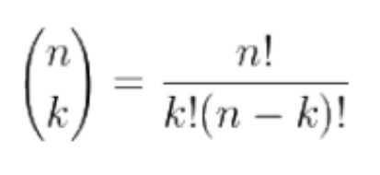
Simple Random Sample (SRS)
SRS: i.e., sample of k elements chosen at random from a set with n elements
Every possible sample (of size k) is equally likely, i.e., it has probability: 1/( )
where:
Every element is equally likely to be in sample
SRS can only be implemented if we know n: (e.g. by a random number generator)
And even then, the resulting size might not be exactly k.
n k

Slide 4
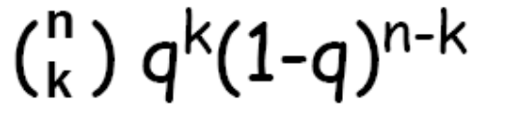
Bernoulli Sampling
Includes each element in the sample with probability q (e.g., if q=1/2 flip a coin)
The sample size is not fixed, sample size is binomially distributed: probability that sample contains k elements is:
Expected sample size is: nq

Slide 5
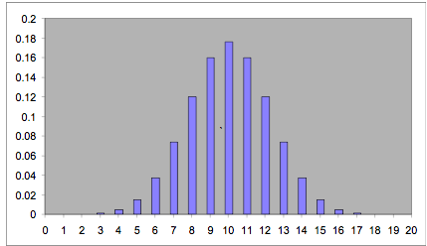
Binomial Distribution -Example

Slide 6
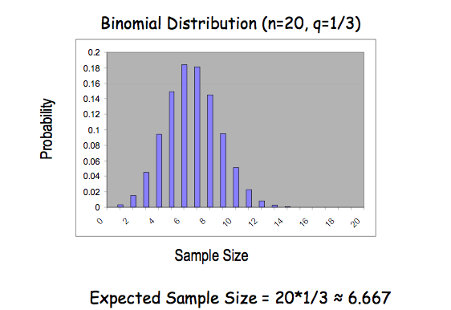
Binomial Distribution -Example

Slide 7
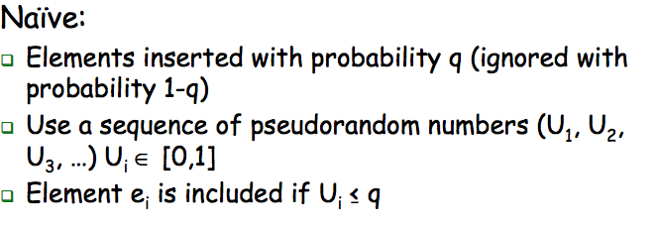
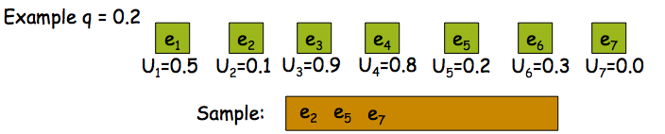
Bernoulli Sampling -Implementation

Slide 8
Bernoulli Sampling: better implementation
By skipping elements…after an insertion
The probability of skipping exactly
zero elements is q
One element is (1-q)q
Two elements is (1-q)(1-q) …
i elements (1-q)^{i} q
The skip has a geometric distribution.

Slide 9
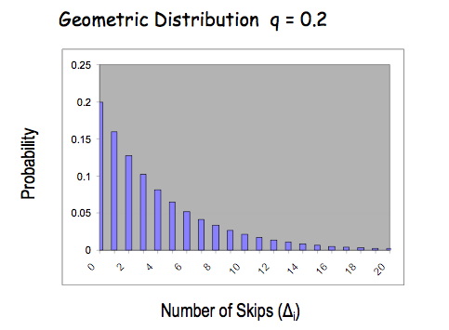

Geometric Skip
This is implemented as:

Slide 10
Reservoir Sampling (Vitter 1985)
Bernoulli sampling: (i) Cannot be used unless n is known, and (ii) if n is known probability k/n only guarantees a sample of approx. size k
Reservoir sampling produces a SRS of specified size k from a set of unknown size n (k <= n)
Algorithm:
Initialize a “reservoir” using first k elements
For every following element j>k, insert with probability k/j (ignore with probability 1- k/j)
The element so inserted replaces a current element from the reservoir selected with probability 1/k.

Slide 11
Reservoir Sampling (cont.)
Insertion probability (pj = k/j, j>k) decreases as j increases
Also, opportunities for an element in the sample to be removed from the sample decrease as j increases
These trends offset each other
Probability of being in final sample is provably the same for all elements of the input.

Slide 12
Windows count-based or time-based
Reservoir sampling can extract k random elements from a set of arbitrary size W
If W grows in size by adding additional elements—no problem.
But windows on streams also loose elements!
  Naïve solution: recompute the k-reservoir from scratch
  Oversampling: Keep a larger window—needs size O(k log n)
  Better solution: next slides?

Slide 13
CBW: Periodic Sampling
When p_{i} expires, take the new element
Pick a sample p_{i} from the first window
Continue…
p₁
p₂
p₃
p₄
p₅
p₆
p₇
p₈
Time

Slide 14
Periodic Sampling: problems
Vulnerability to malicious behavior
  Given one sample, it is possible to predict all future samples
Poor representation of periodic data
  If the period “agrees” with the sample
Unacceptable for most applications

Slide 15
Chain Method for Count Based Windows
[Babcock et al. SODA 2002]
Include each new element in the sample with probability 1/min(i,n)
As each element is added to the sample, choose the index of the element that will replace it when it expires
When the i^{th} element expires, the window will be
(i+1, …, i+n), so choose the index from this range
Once the element with that index arrives, store it and choose the index that will replace it in turn, building a “chain” of potential replacements
When an element is chosen to be discarded from the sample, discard its “chain” as well

Slide 16
Memory Usage of Chain-Sample
Let T(x) denote the expected length of the chain from the element with index i when the most recent index is i+x
The expected length of each chain is less than T(n) ≈ e ≈ 2.718
If the window contains k sample this be repeated k times (while avoiding collisions)
Expected memory usage is O(k)
_{j<i}

Slide 17
Timestamp-Based Windows (TBW)
Window at time t consists of all elements whose arrival timestamp is at least t’ = t-m
The number of elements in the window is not known in advance and may vary over time
The chain algorithm does not work
  Since it requires windows with a constant, known number of elements

Slide 18
Sampling TBWs
[Babcock et al. SODA 2002]
Imagine that all n elements in the window are assigned a random priority between 0 and 1
The living element with max (or min) priority is a valid sample of the window …
As in the case of the max UDA, we can discard all window elements that are dominated by a later-time+higher priority pair.
For k samples, simply find the top-k tuples…
Therefore expected memory usage is O(log n), or O(k log n) for samples of size k. O(k log n) is also an upper bound (whp)

Slide 19
Comparison of Algorithms for CBW
Algorithm | Expected | High-Probability
Periodic | O(k) | O(k)
Oversample | O(k log n) | O(k log n)
Chain-Sample | O(k) | O(k log n)

Slide 20
An Optimal Algorithm for CBW
O(k) memory: [Braverman et al. PODS 09]
For k samples over a count-based widow of size W:
The stream is logically divided into tumbles of size W—called buckets in the paper.
For each bucket, maintain k random samples by the reservoir algorithm
As the window of size W slides over the buckets, you draw samples from the old bucket and the new one.
p₁
p₂
p₃
p₄
p₅
p₆
p₇
p₈
p₉
p₁₀
p_{N-6}
p_{N-5}
p_{N-4}
p_{N-3}
p_{N-2}
p_{N-1}
p_{N}
p_{N+1}
p_{N+2}
p_{N+3}
….
B₁
B₂
B_{N/n}
B_{N/n+1}
Time

Slide 21
The active windows slides over two buckets: the old one where the samples are known, and the new one with some future elements
Active sliding
window
Future element
Expired element
p₁
p₂
p₃
p₄
p₅
p₆
p₇
p₈
p₉
p₁₀
p_{N-6}
p_{N-5}
p_{N-4}
p_{N-3}
p_{N-2}
p_{N-1}
p_{N}
p_{N+1}
p_{N+2}
p_{N+3}
….
B₁
B₂
B_{N/n}
B_{N/n+1}
Time
Bucket
(size 5)

Slide 22


Bucket of size 5: Sample of size 1
X
R₁
R₂
p_{N-6}
p_{N-5}
p_{N-4}
p_{N-3}
p_{N-2}
p_{N-1}
p_{N}
p_{N+1}
p_{N+2}
p_{N+3}
….
….
B_{N/n}
B_{N/n+1}
Time
Old bucket: s expired
  N-s active
New bucket: s active
  N-s future
Reservoir sampling
used to compute R₂

Slide 23

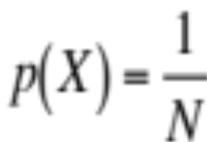
How to Select one sample out of a window of N elements.
Step1: Select a random X between 1 and N
Step2: X is not yet expired take it.
Old bucket:
  s: expired
  N-s: active
New bucket:
  s: active
  N-s: future
X
p_{N-6}
p_{N-5}
p_{N-4}
p_{N-3}
p_{N-2}
p_{N-1}
p_{N}
p_{N+1}
p_{N+2}
p_{N+3}
….
….
B_{N/M}
B_{N/M+1}
Time
Single sample:

Slide 24

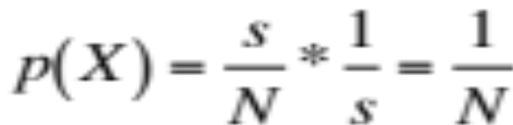
Step 2: X corresponds to an element p that has expired. In that case, take a single reservoir sample from the active segment of new window (s such elements)
X
R₁
R₂
p_{N-6}
p_{N-5}
p_{N-4}
p_{N-3}
p_{N-2}
p_{N-1}
p_{N}
p_{N+1}
p_{N+2}
p_{N+3}
….
….
B_{N/n}
B_{N/n+1}
Time

Slide 25
Results: optimal solutions for all cases of uniform random sampling from sliding windows
Sampling method
 | Sequence-based | Timestamp-based
With Replacement | O(k) | O(k*log n)
Without Replacement | O(k) | O(k*log n)
Window

